Slide 1


Slide 2
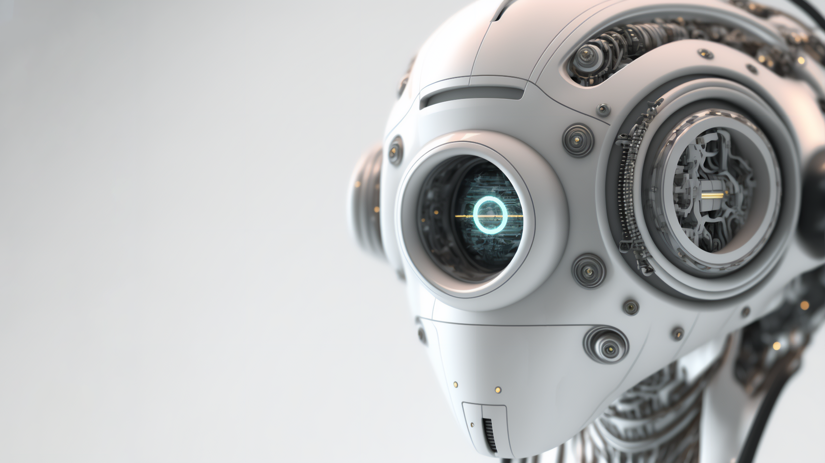



















Introduction
Problem Statement
Emotion Detection
Course: Artificial Intelligence.
ID: 1803510201664. Sec: A
Presented by
Sayed MD. Sadik Iqbal Akil
Solution/Implementation
Sample code
Future Scope

Slide 3
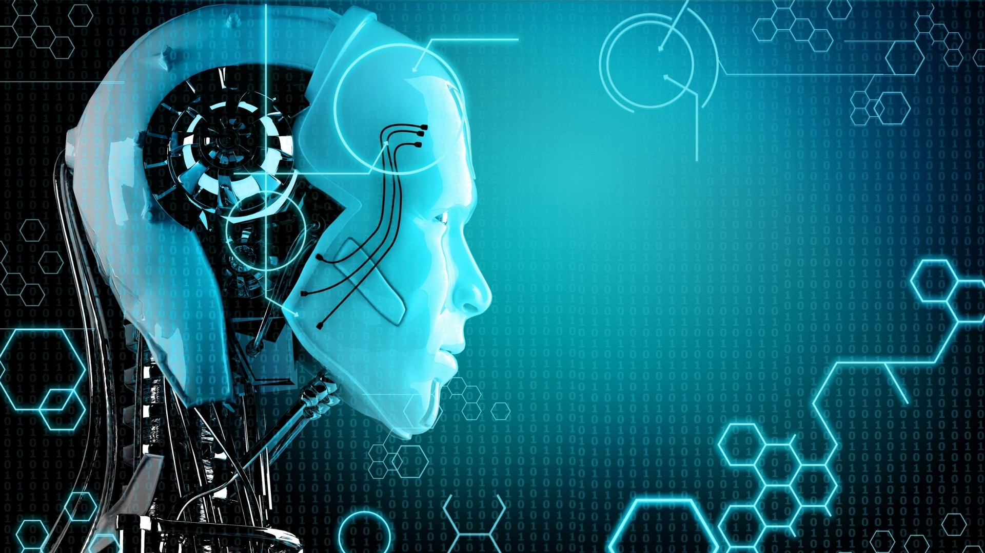
CONTENT
Introduction.
Problem Statement.
Solution.
Implementation.
Sample Code.
Future Scope.

Slide 4
INTRODUCTION
Emotion detection has numerous practical applications in various industries, including healthcare, marketing, education, and customer service. For example, in healthcare, emotion detection can be used to detect and monitor patients' emotions to better diagnose and treat mental health disorders such as depression and anxiety. In marketing, emotion detection can be used to analyze customers' emotional responses to products and advertisements to better understand their preferences and needs.
In this presentation, we will explore the different methods and technologies used in emotion detection, discuss the challenges and limitations of the field, and examine some of the exciting applications and potential future developments in this rapidly evolving area of artificial intelligence.

Slide 5
PROBLEM STATEMENT
Technical Challenges:
Emotion Detection shares a lot of challenges with detecting moving objects. Such as video identifying an object, continuous detection in complete action etc.
Data Augmentation:
As with any machine learning and deep learning algorithms. ER solution require a lot of training data. This data must include videos at various frame rates, from various angles, with various background with people of different gender, nationalities etc.

Slide 6


SOLUTION
Create Your own Dataset:
This is the most expensive and time consuming way, But you will end up with a data set. It’s perfectly suited for your task. Here I using 5 Data set- Angry, Happy, Neutral sad, Surprise.
Combine several Dataset:
You can cross check the performance of your solution on several other datasets.

Slide 7
IMPLEMENTATION
OpenCV
OpenCV is the library we will be using for image transformation functions such as converting the image to grayscale.
Python
Python is a powerful is a scripting language and is very useful for solving statistical problems involving machine learning algorithms.
Deep Learning
Deep learning is a subset of machine learning inartificial intelligence
Keras
Keras is an open-source software library that provides a Python interface for artificial neural networks.
NumPy
NumPy is a library for the Python programming language. Adding support for large multi-dimensional array.

Slide 8

SAMPLE CODE
from keras.models import load_model
from time import sleep
from keras.preprocessing.image import img_to_array
from keras.preprocessing import image
import cv2
import numpy as np
face_classifier = cv2.CascadeClassifier('./haarcascade_frontalface_default.xml’)
classifier =load_model('./Emotion_Detection.h5’)
class_labels = ['Angry','Happy','Neutral','Sad','Surprise’]
cap = cv2.VideoCapture(0)
while True:
# Grab a single frame of video
ret, frame = cap.read() labels = [] gray = cv2.cvtColor(frame,cv2.COLOR_BGR2GRAY)
faces = face_classifier.detectMultiScale(gray,1.3,5)
for (x,y,w,h) in faces:
cv2.rectangle(frame,(x,y),(x+w,y+h),(255,0,0),2)
roi_gray = gray[y:y+h,x:x+w] roi_gray = cv2.resize(roi_gray,(48,48),interpolation=cv2.INTER_AREA)
if
np.sum([roi_gray])!=0: roi = roi_gray.astype('float')/255.0 roi = img_to_array(roi) roi = np.expand_dims(roi,axis=0) # make a prediction on the ROI, then lookup the class preds = classifier.predict(roi)[0] print("\nprediction = ",preds) label=class_labels[preds.argmax()] print("\nprediction max = ",preds.argmax()) print("\nlabel = ",label) label_position = (x,y) cv2.putText(frame,label,label_position,cv2.FONT_HERSHEY_SIMPLEX,2,(0,255,0),3)
else:
cv2.putText(frame,'No Face Found',(20,60),cv2.FONT_HERSHEY_SIMPLEX,2,(0,255,0),3) print("\n\n") cv2.imshow('Emotion Detector',frame) if cv2.waitKey(1) & 0xFF == ord('q'):
break cap.
release()
cv2.destroyAllWindows()

Slide 9


FUTURE SCOPE
Automotive Safety And Recharge System
Medical recherché into Autism
Market Research
Pay-per-laugh

Slide 10


REFERECE
Reference:
https://www.kaggle.com/
THANKS

